Slide 1
Black Swan Impact Predictor
Group no: 7
Dhruvi Shah
Hanguyan Xu
Puneet Tokhi
Sandesh Gupta

Slide 2

What is Black Swan
Actual bird which is rare
Termed coined by Nassim Nicholas Taleb
A metaphor that describes an event that comes as a surprise and has a major effect
Examples of Black Swan Events
COVID 19: Recent BlackSwan event
2008 Housing Market crash
9/11 terrorist attacks

Slide 3
Objectives (Use cases)
Predict a score for a particular news article and analyze its impact on the stock market.
Help both the institutional and individual investors prepare in advance for future black swan events.
Protect individual portfolio’s from market crash by giving them a heads up about potential market swings based on global headlines.

Slide 4
Persona
Investment Bankers
Institutional Investors
Fund managers
Individual Investors

Slide 5
Demo

Slide 6
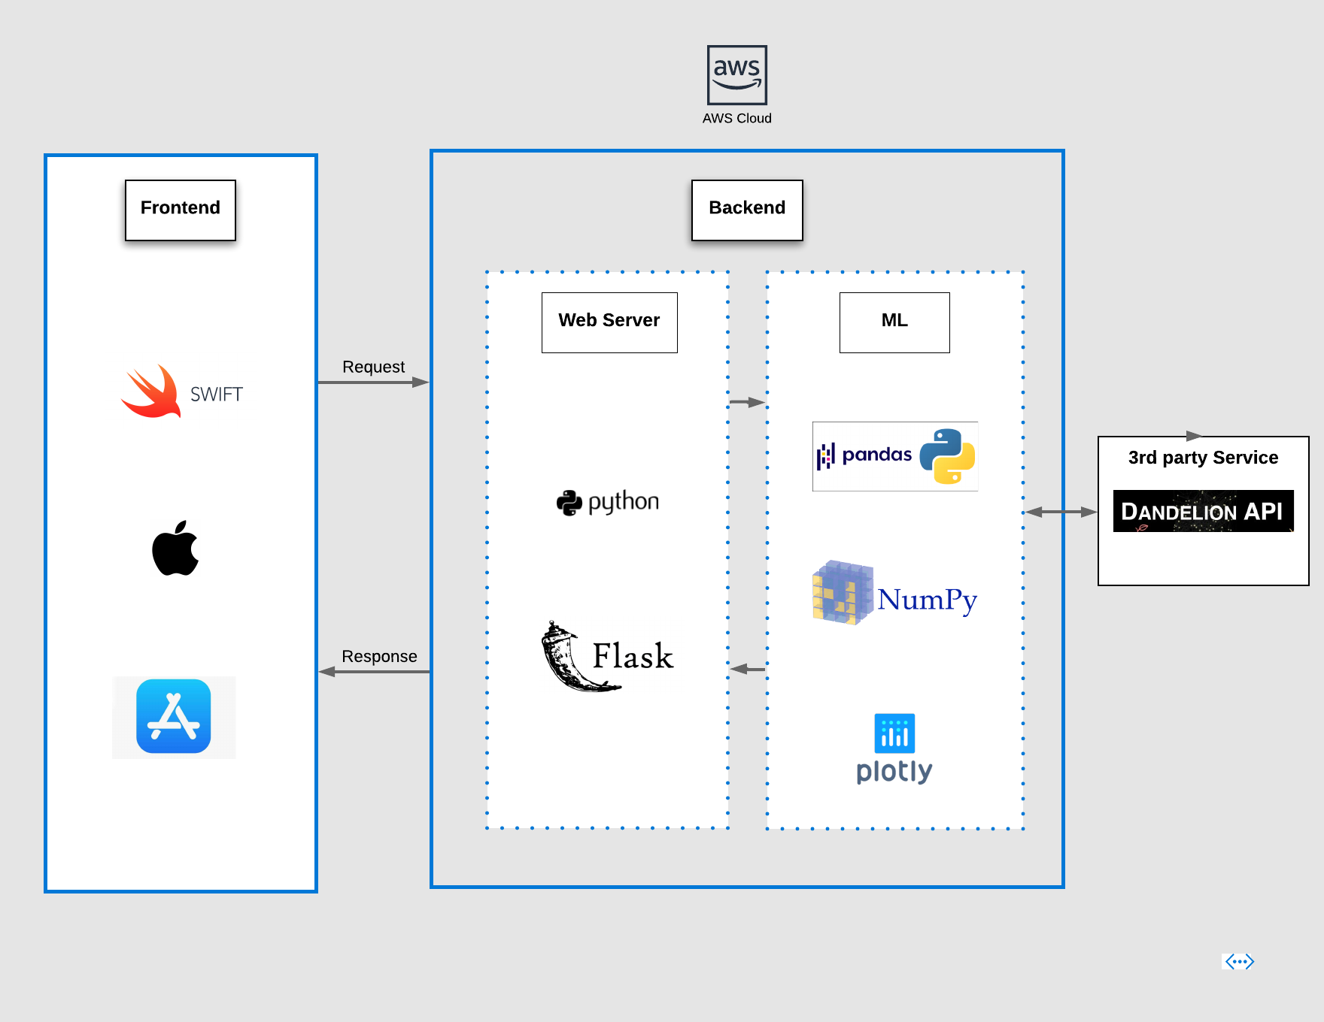
Architecture Diagram

Slide 7
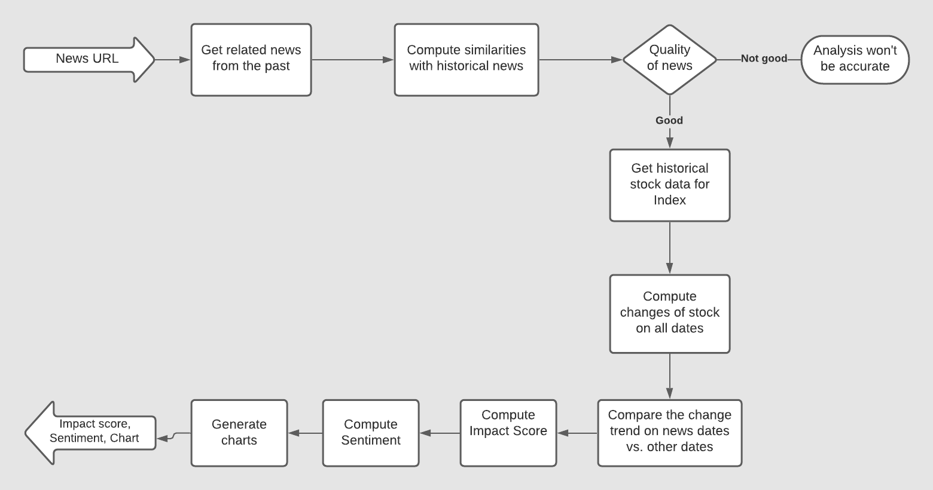
ML Model Flow

Slide 8
Further improvements
The news analysis service can be exposed as a public API (SaaS) to be used by multiple news portals.
In the future, we can train the model with more data to increase the accuracy.
Alert the users with a push notification so that action can be taken promptly.
With the help of a large dataset, we can introduce automatic prediction function, which can help people broaden their vision and avoid market risks.

Slide 9
Conclusion
Understand how news events have an impact on the stock market.
Prepare investors protect their portfolio’s against a black swan event
Investors and hedge fund managers can use our app to analyze the stock market before investing.
Investors can think about the results and understand why a particular Black Swan event had a positive or negative impact on the stock price

Slide 10
Thank you

